Slide 1


Slide 2
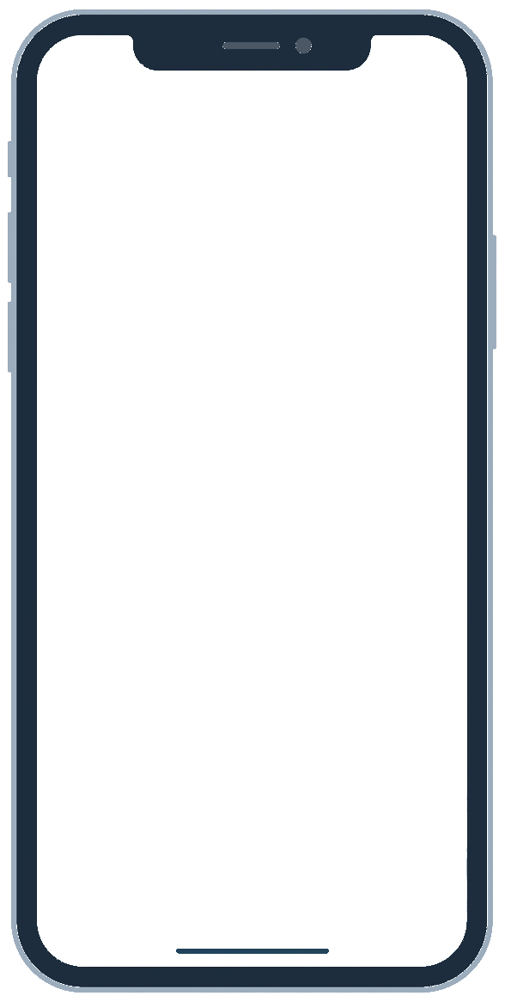
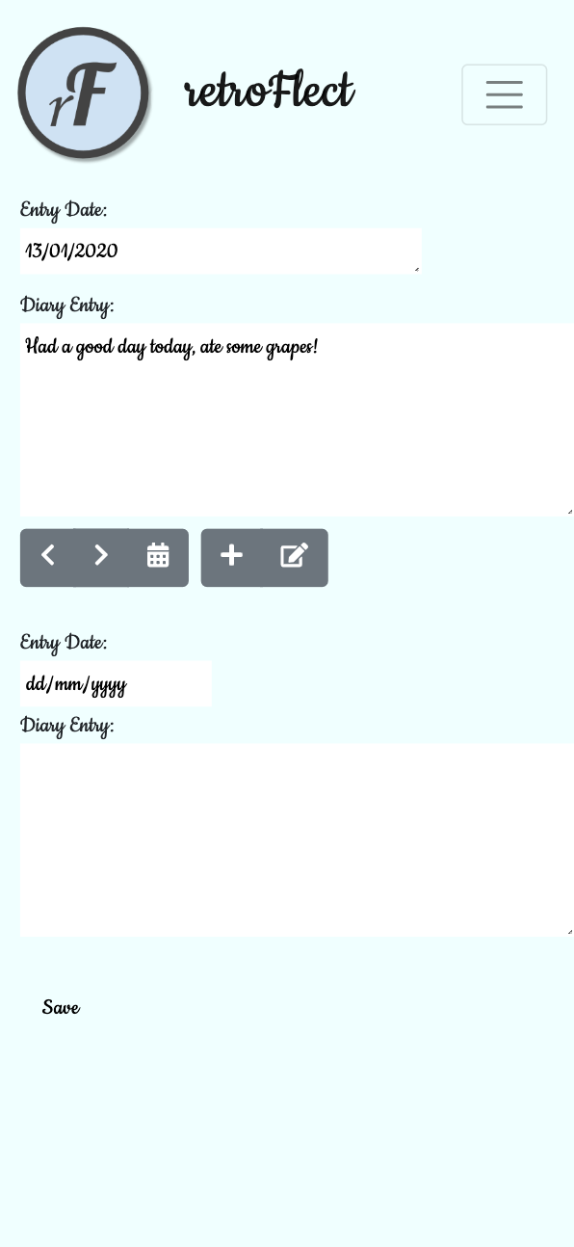

retroFlect
self-reflection assistant
THE hottest innovation in wellbeing technology

Slide 3
What is it for?
Who is it for?
A wellbeing app with a mission to help you keep track of your thoughts, habits and general mental and emotional health.
Reflect on your day in a structured way.
Bring your best self to the world.
Track your wellbeing journey!
Meet Selina:
Struggles to sleep
Racing mind
Needs an outlet for emotional release

Slide 4
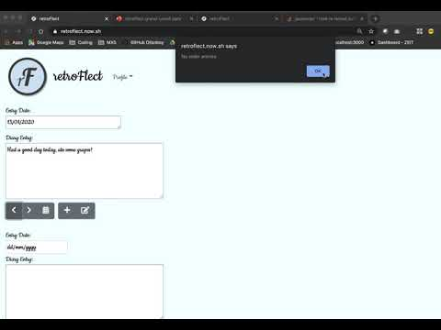

Slide 5
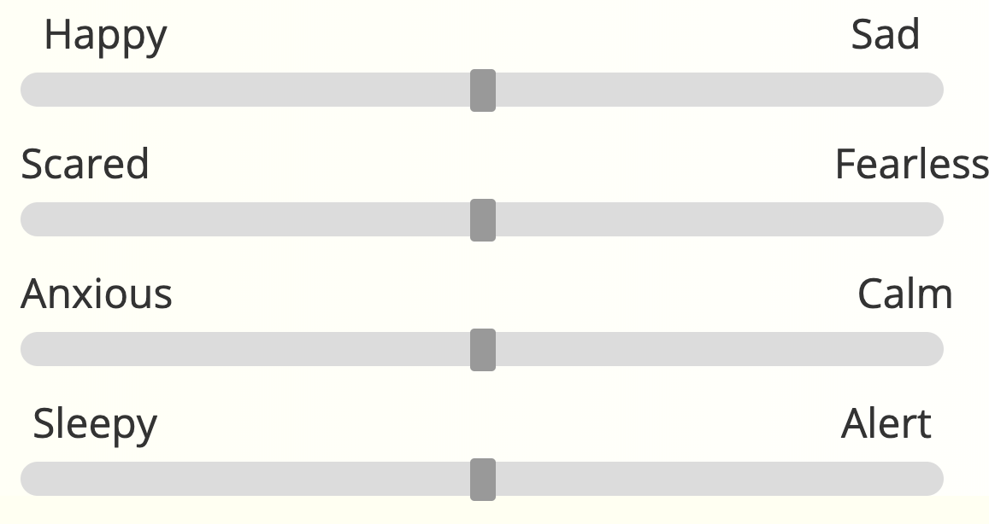

Future Features To Implement
Quick Recap Of Features
Sign In
Sign Out
Register/Sign Up
View all your previous entries
Create a new diary entry
Mood sliders
Gratitude entries
Better display of previous entries in carousel

Slide 6


The Tech stack

Slide 7
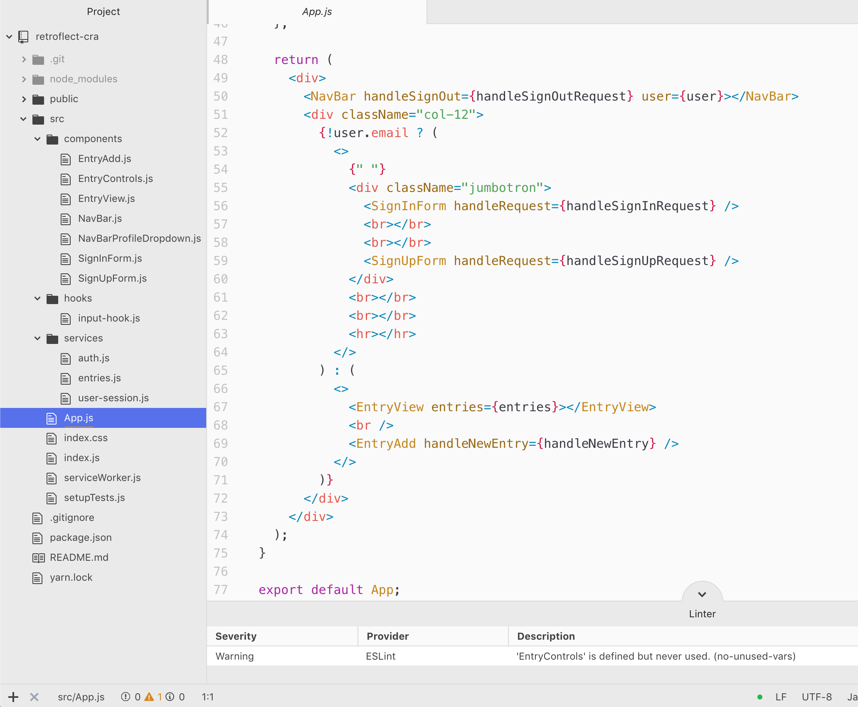
Front End
React
Next.js (used initially then removed later)
Axios (HTTP client)
Bootstrap
End to end testing with Cypress
ESLint

Slide 8
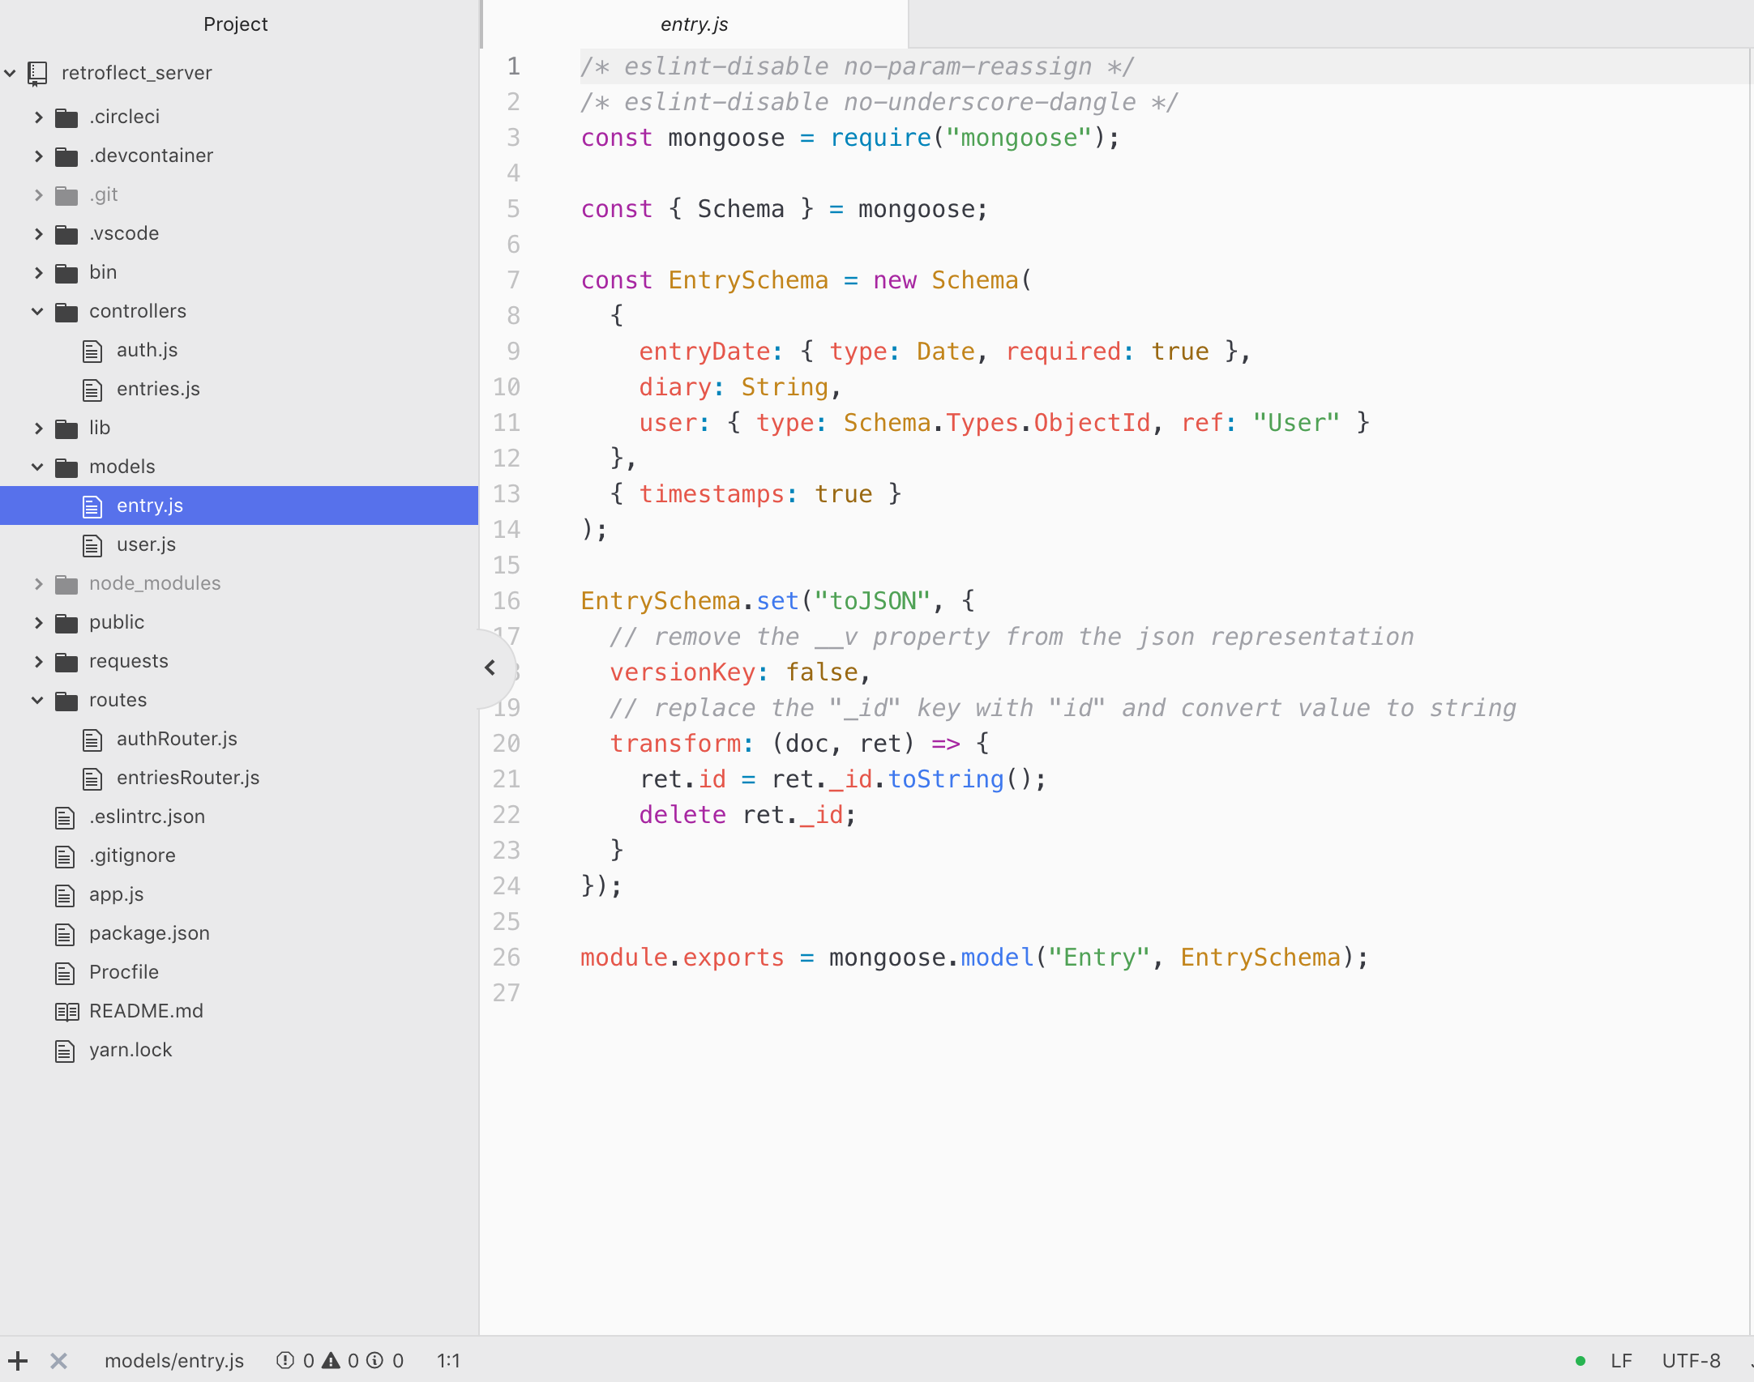
BACK End
Node.js
Express.js
Mongo.db

Slide 9
Challenges Learning Opportunities
How We
Overcame Them
Available time to learn new things on ReactJS and software development practices
Did not initialise our project directory with Linter
Starting over (x4!)
Planning could have been better
Working effectively as a team
Learning to scan through lots of resources quickly
Used the GitHub wiki to create a resources board
We started over with Linter installed.
We re-used blocks of code where possible.
We employed scrum methodologies to break down projects and assign them to team members
We had a frank discussion where we aired our views so that we could move forward in agreement

Slide 10
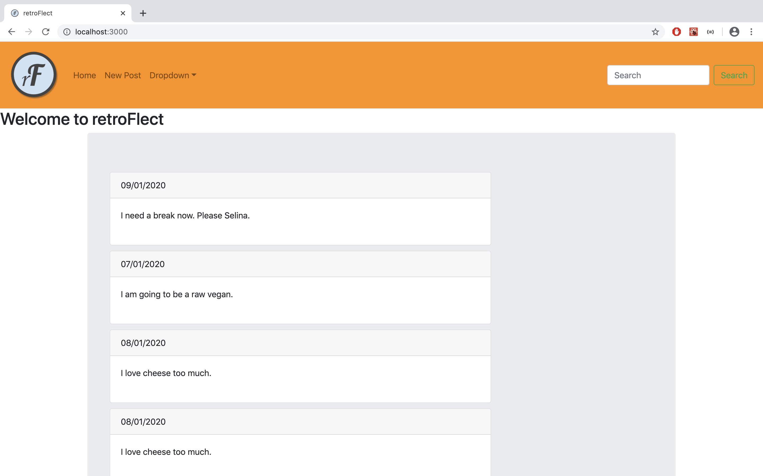
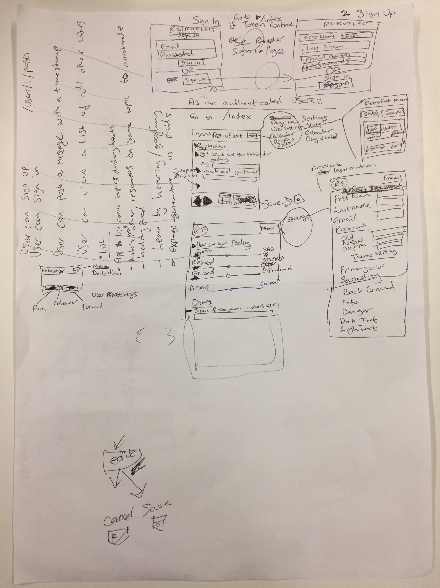
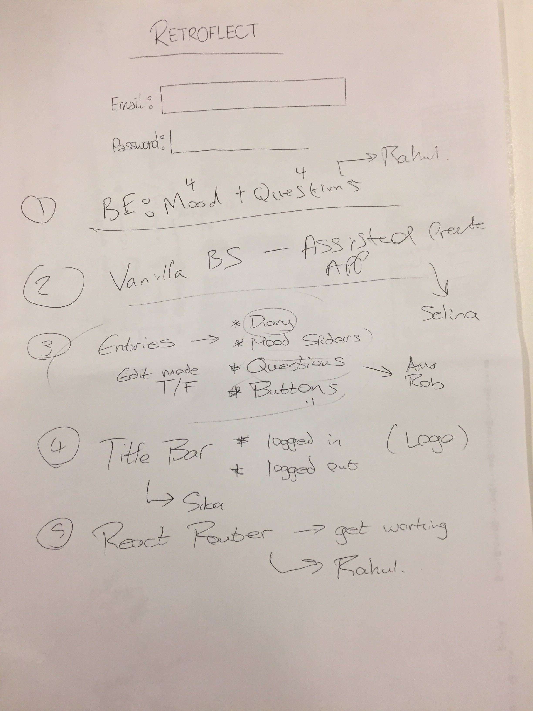
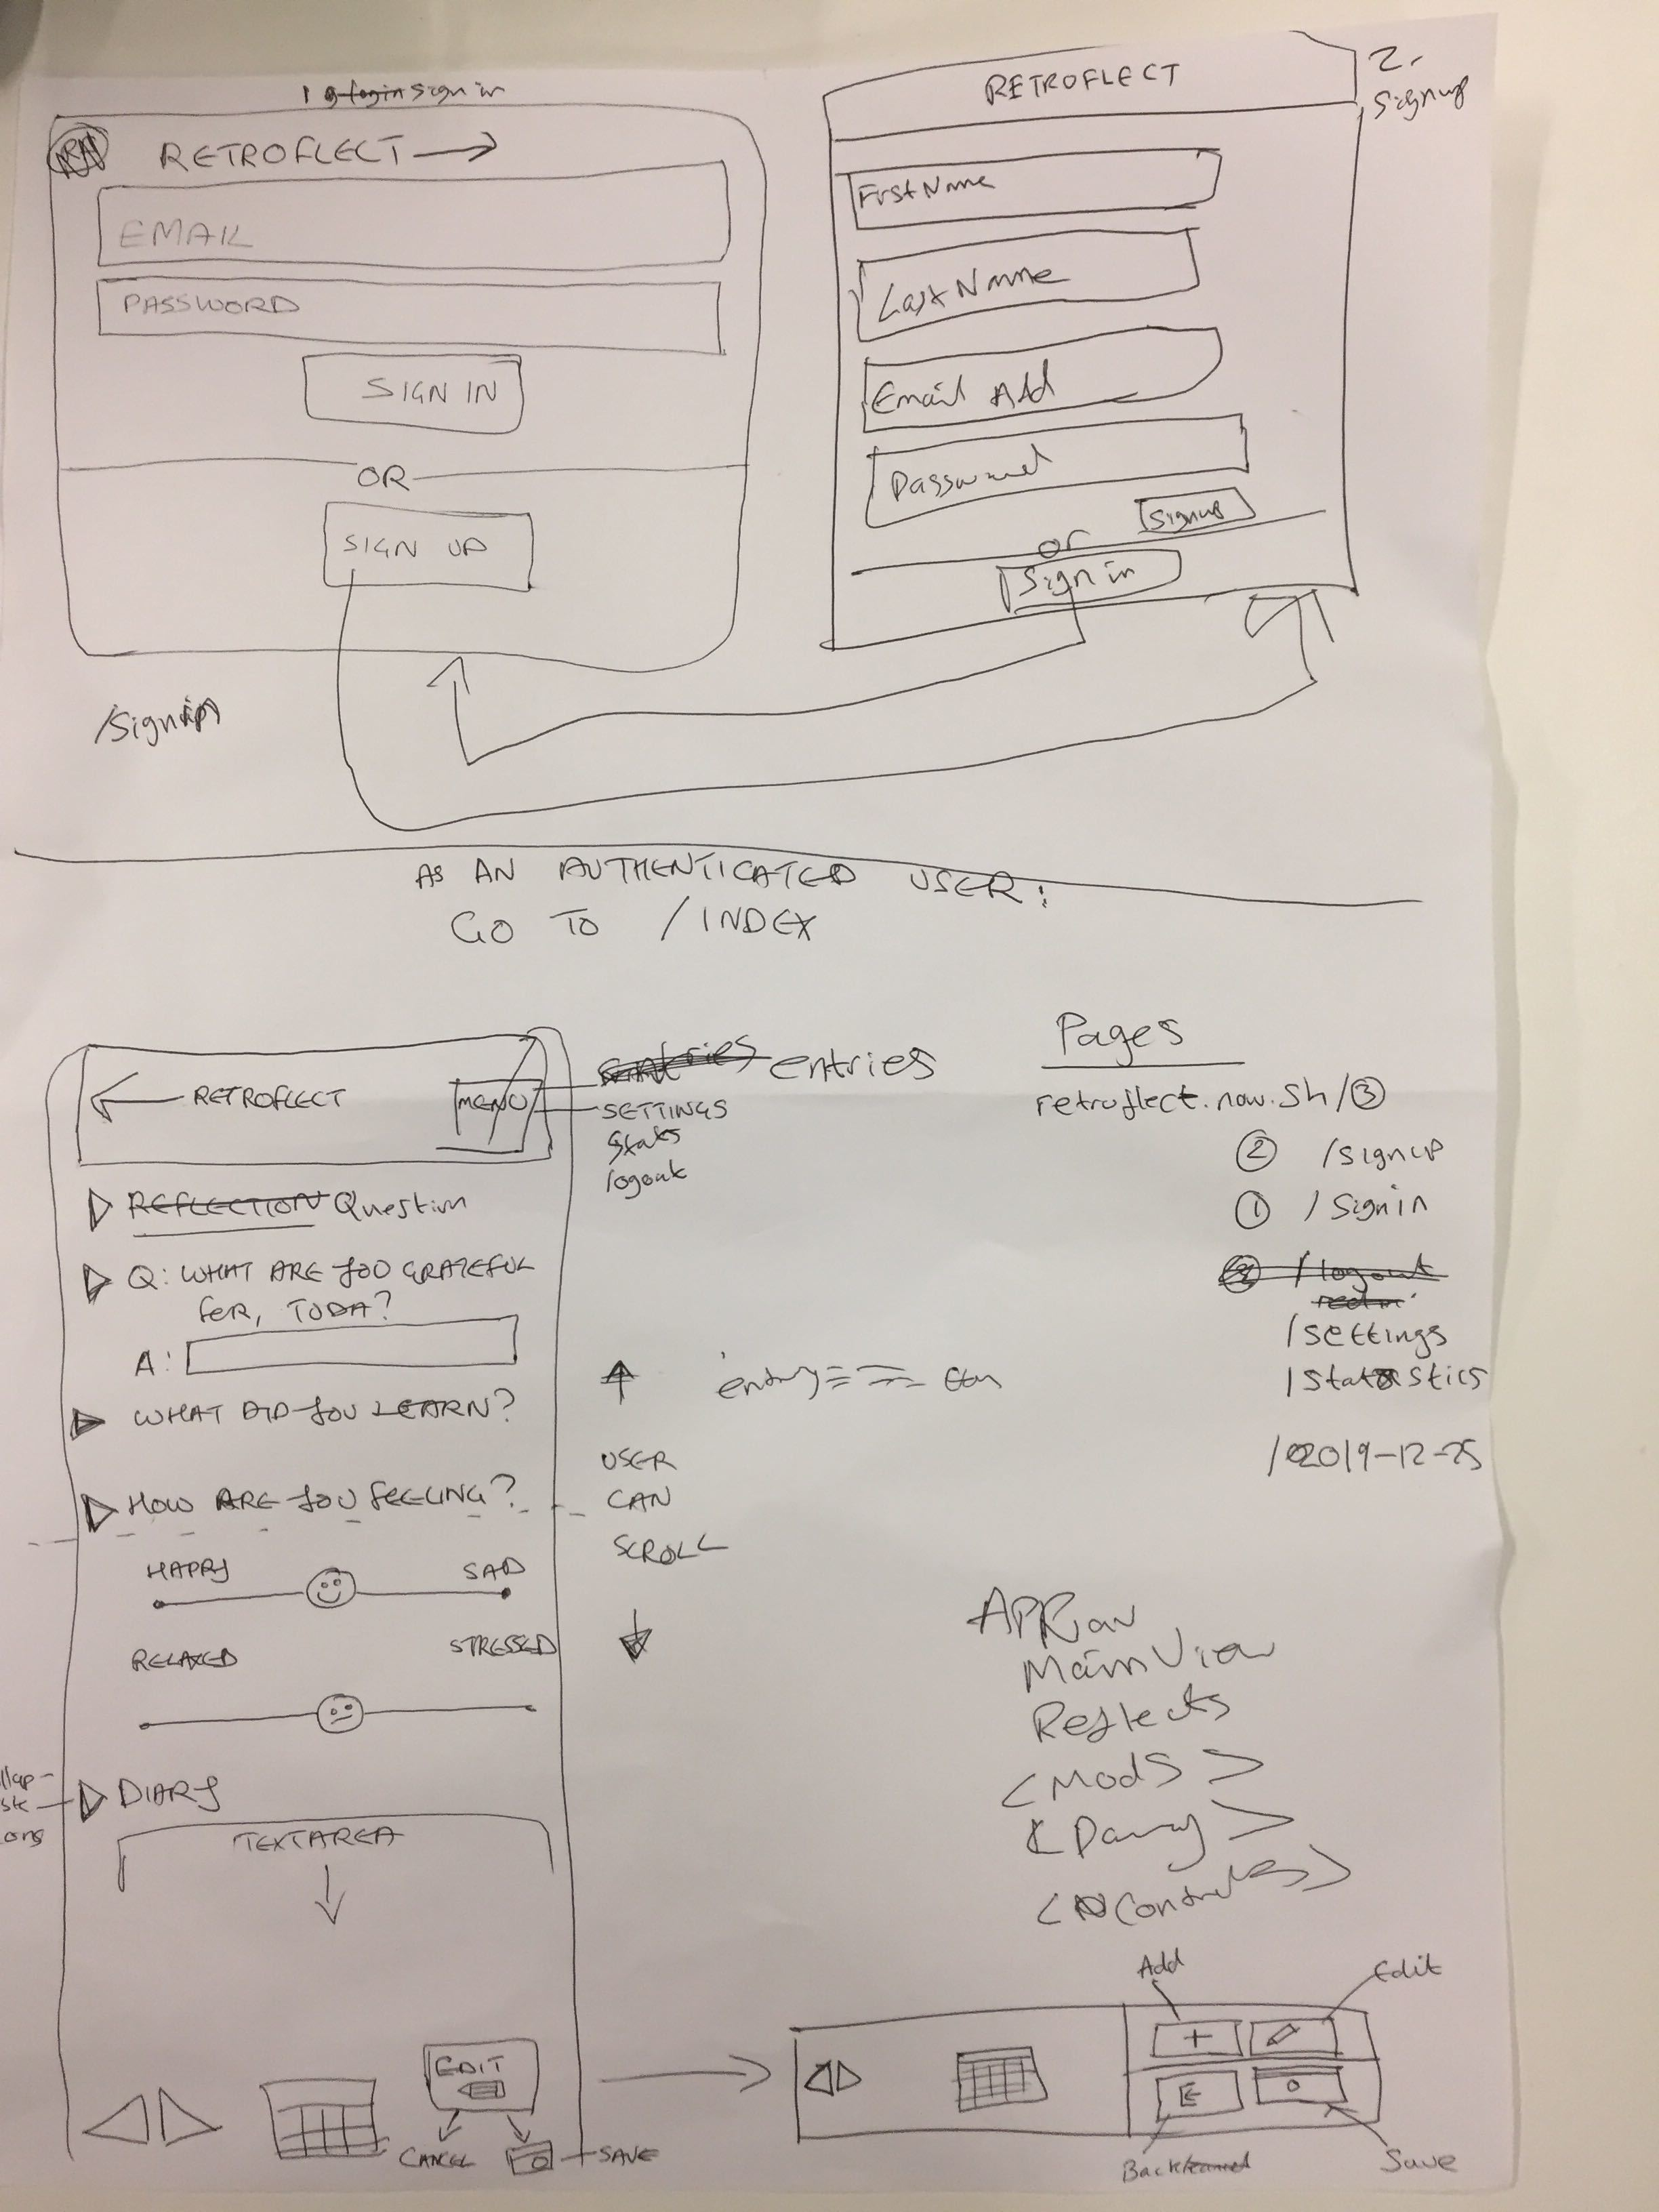
Organised Chaos...

Slide 11
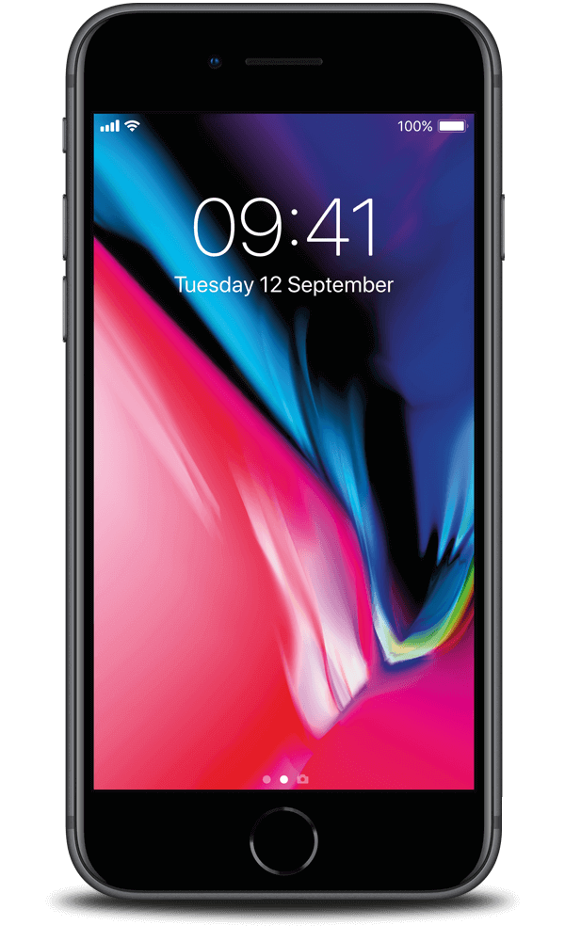
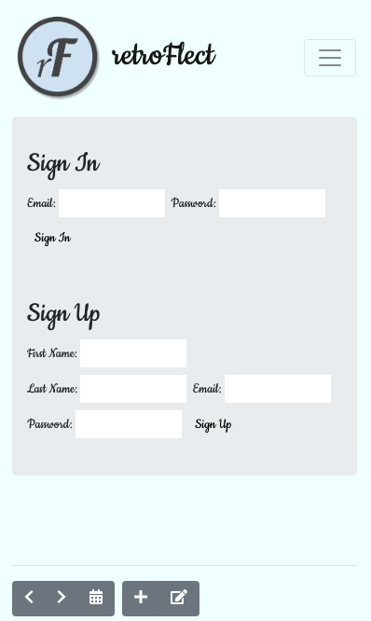
Thank you

